Slide 1

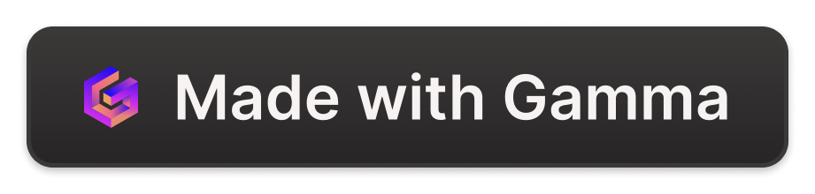
PROJECT NAME :
STUDENT EXPENCES
This project focuses on analyzing student monthly expenses using Python libraries such as NumPy, Pandas, and Matplotlib. The dataset, obtained from Kaggle, will be used to perform data science tasks.
SUBMITED BY:
P Sai Venkata Siva Raju (psivaraj2003@gmail.com)
P Teja Kumar (tejakumarpasupuleti22@gmail.com)
K Heaven Jyothi (heavenjyothi@gmail.com)

Slide 2
Overview of the dataset from Kaggle
Data Source
Data Size
Data Features
The dataset was sourced from Kaggle, a popular platform for data science and machine learning datasets.
The dataset consists of a substantial amount of data points, allowing for in-depth analysis and insights.
It contains various features related to student monthly expenses, enabling comprehensive analysis and modeling.

Slide 3
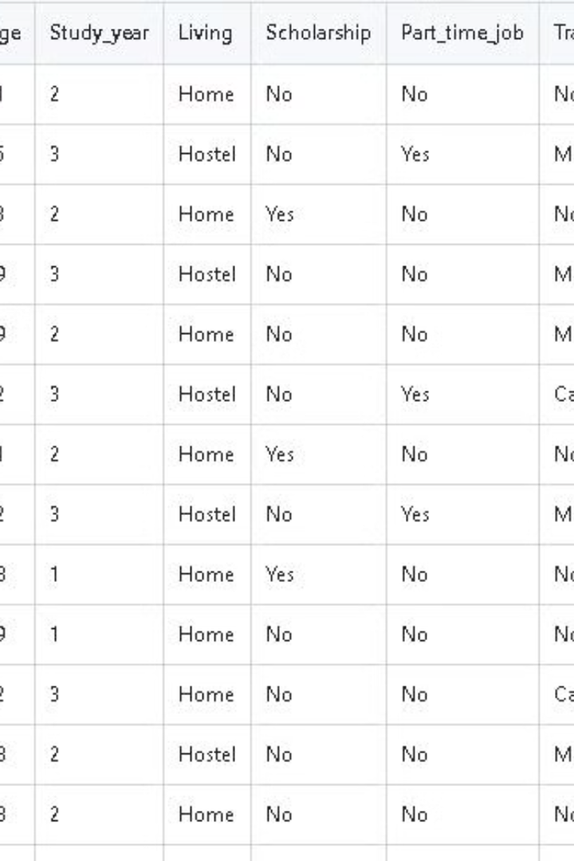
Data Preprocessing using Python and NumPy
Before conducting analysis, raw data is cleaned and organized using Python and NumPy. This involves handling missing values, standardizing data, and preparing it for visualization.
Python offers powerful tools for data cleaning, and NumPy provides efficient array operations for numerical data manipulation.

Slide 4
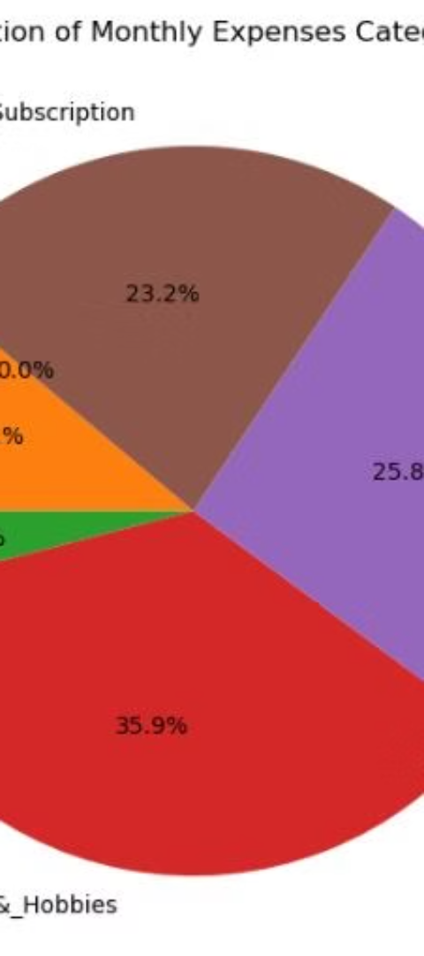
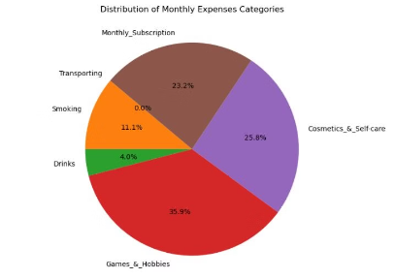
Data Analysis and Visualization with Pandas and Matplotlib
1
Data Cleaning
Use Pandas to remove null values and format data for analysis.
2
Statistical Analysis
Utilize Pandas to calculate mean, median, and standard deviation for key expense categories.
3
Graphical Visualization
Utilize Matplotlib to create visual representations of monthly expense trends.

Slide 5
Monthly Expenses Trends and Patterns
Spending Patterns
Seasonal Variations
Core Expenses vs. Discretionary Spending
Emerging Trends
Identifying trends in monthly expenses helps in understanding spending habits and making informed budgeting decisions.
Tracking expenses over the months can illustrate seasonal variations, such as higher heating costs in winter or increased travel expenses in summer.
Analysis can uncover emerging trends in spending behavior, such as increased investment in health and wellness or growing interest in sustainable products and services.
Patterns can distinguish between core essential expenses and discretionary spending, providing insights into financial priorities and areas for adjustment.
It can reveal areas of overspending and opportunities for saving.

Slide 6
Correlation analysis between different expense categories
Housing and Utilities
Transportation and Fuel
There might be a positive correlation between rent/mortgage and electricity/water bills.
Analyze the correlation between vehicle maintenance costs and fuel expenses.
Entertainment and Dining Out
Health and Wellness
Explore the relationship between entertainment spending and dining out expenses.
Investigate the correlation between gym memberships and medical expenses.

Slide 7




Predictive modeling for future expenses
Data Collection
1
Gathering relevant data from various sources
Feature Selection
2
Choosing the most influential variables for the model
Model Building
3
Constructing predictive algorithms using the selected features
Evaluation
4
Assessing the accuracy and performance of the model

Slide 8
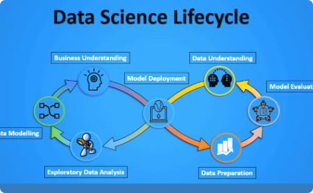
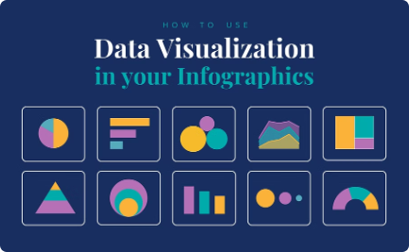
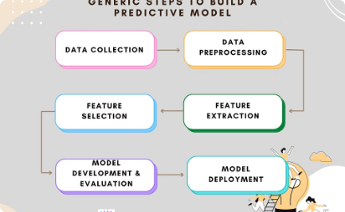
Evaluation of the data science project
Performance Metrics
Data Analysis Visuals
Predictive Modeling Results
Evaluating the project's success through performance metrics such as accuracy, precision, recall, and F1-score.
Reviewing the visualizations created using Pandas and Matplotlib to gain insights into the dataset.
Analyzing the accuracy and performance of the predictive model for future expense predictions.

Slide 9

Conclusion and Next Steps
After evaluating the monthly expenses data and developing predictive models, the next step is to analyze the accuracy of the models and identify potential areas of improvement. Additionally, documenting the entire process and creating a detailed report for stakeholders is crucial for transparency and future reference.
Furthermore, considering the potential integration of additional data sources for enhanced predictive capabilities and conducting regular evaluations to ensure the continued relevance of the models will be essential for sustained efficiency.

Slide 10



References and Resources
Dataset
Python Libraries
Data Science Project
Kaggle provides access to various datasets, including the "Student Monthly Expenses" dataset used in this project.
NumPy, Pandas, and Matplotlib are essential libraries used for data preprocessing, analysis, and visualization in this project.
Explore more data science projects, tutorials, and resources on platforms like Kaggle and GitHub to enhance your skills.

